Slide 1
Milestone 2-- Education Input & Preprocessing
Build the interface & backend logic to collect education details → validate → preprocess → store clean data usable by ML model.

Slide 2
Day 1 — Introduction to Milestone 2
Theory
What is data preprocessing?
Why ML models need clean, encoded, normalized inputs.
Common preprocessing tasks: encoding, normalization, handling missing values.
Overview of user education data: degree, specialization, CGPA, year, certifications.
Hands-on
Design form structure (UI planning).
List all required input fields.
Outcome: Students understand what data needs to be collected & why.

Slide 3
1. What is Data Preprocessing?
Data preprocessing is the step where we clean, format, and transform raw user input into a form that a machine learning model can understand. Raw data → Clean, numerical, structured data.
2. Why ML Models Need Clean, Encoded, Normalized Inputs?
ML algorithms cannot understand text like “B.Tech”, “CSE”, or “Good CGPA”.
They require numerical values.
If data is inconsistent (blank fields, mixed formats), predictions become inaccurate.
Normalization ensures all values fall in a similar range (e.g., CGPA 0–10), helping the model learn better.
3. Common Preprocessing Tasks
Encoding: Convert text to numbers Example:
B.Tech → 1
M.Tech → 2
Normalization: Scale CGPA or scores to a consistent range
Handling Missing Values:
Fill with averages
Use “Unknown” category
Prevent errors during prediction
4. Overview of User Education Data
These fields are required to suggest job roles:
Degree (B.Tech, M.Tech, BSc, etc.)
Specialization (CSE, ECE, IT, Mechanical, etc.)
CGPA / Percentage
Year of Graduation
Certifications (AI/ML, Java, Python, Cloud, etc.)
This data will later be:
Validated
Cleaned
Encoded
Sent to ML model for job prediction

Slide 4
🛠 Hands-On (Quick & Practical)
1. Design Form Structure (UI Planning)
Students decide:
Layout of the form
Input types (text field, dropdown, number input, file upload)
Arrangement for user-friendly experience
2. List All Required Input Fields
Students prepare a list like:
Degree
Specialization
CGPA
Graduation Year
Certifications (optional)

Slide 5
🎯 Outcome (End of Day 1)
By the end of Day 1, students clearly understand:
What data they need from the user
Why each field is important
How this data will be used later for ML predictions
How to plan and design the form UI

Slide 6
Day 2 — Building Education Input Form (Frontend)
Theory
Designing forms using React / HTML + Tailwind.
Input types: text, dropdowns, radio buttons, number fields.
UX best practices for academic forms.
Hands-on
Create Education Details Form UI.
Add basic state handling (React useState or form libraries).
Outcome: Frontend form created.

Slide 7
1. Designing Forms Using React / HTML + Tailwind
Students learn how to create user-friendly forms using:
HTML form elements
React components
Tailwind CSS for styling
Key concepts:
Reusable input components
Controlled vs uncontrolled components
Layout using flex/grid
Tailwind utility classes for spacing, labels, responsiveness

Slide 8
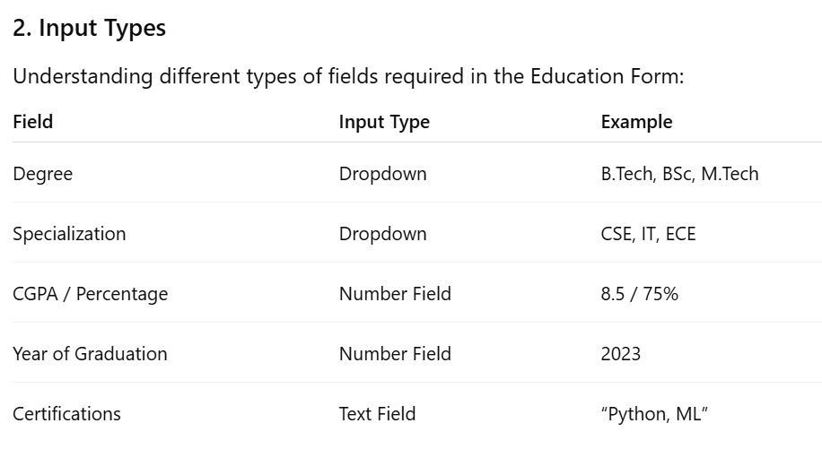

Slide 9
Additional input types:
Radio buttons (Full-time / Part-time)
Textarea (Optional notes/courses)

Slide 10
3. UX Best Practices for Academic Forms
Use dropdowns for predictable fields (degree, specialization).
Place labels above inputs for clarity.
Group related fields together (e.g., Academic Information section).
Avoid too many text fields—use structured inputs.
Provide hints or placeholders (e.g., “Enter CGPA out of 10”).
Ensure the form is responsive and mobile-friendly.

Slide 11
🛠 Hands-On (Practical Work)
1. Create Education Details Form UI
Students build the actual form with:
Degree dropdown
Specialization dropdown
CGPA input
Year input
Certifications text field
Use basic Tailwind classes:
<div class="flex flex-col gap-4 p-4">

Slide 12
2. Add Basic State Handling
Using React useState:
const [degree, setDegree] = useState("");
const [specialization, setSpecialization] = useState("");
const [cgpa, setCgpa] = useState("");
const [year, setYear] = useState("");
Or using a form library (optional):
Formik
React Hook Form
Students connect each input → state variable.

Slide 13
🎯 Outcome (End of Day 2)
By the end of Day 2:
A clean, user-friendly Education Input Form UI is created.
Basic state handling is working (form fields store values).
Form is visually structured with Tailwind CSS.
The form is now ready for Day 3: Validation.

Slide 14
Day 3 — Form Validation Basics
Theory
What is validation?
Types:
Client-side (instant feedback)
Server-side (security & consistency)
Required fields, numeric range checks (CGPA 0–10), date validation.
Hands-on
Implement validation for each input.
Show error messages below fields.
Outcome: Clean, validated data on frontend.

Slide 15
1. What is Validation?
Validation is the process of checking whether the user's input is correct, complete, and in the right format before submitting it to the backend.
It helps ensure:
Accurate data
Consistent data
No errors or invalid entries
Better user experience

Slide 16
2. Types of Validation
A. Client-Side Validation (Frontend)
Happens instantly in the browser.
Gives quick feedback to the user.
Example:
“CGPA must be between 0 and 10”
“Degree field cannot be empty”
Purpose: Improve UX and reduce incorrect submissions.

Slide 17
B. Server-Side Validation (Backend)
Happens after the data is sent to the server.
Ensures the data is safe and trustworthy.
Prevents:
Tampering
Invalid formats
Security issues
Purpose: Ensure system reliability and database safety.

Slide 18
3. Common Validation Checks for Education Form
Required fields
Degree
Specialization
Year of graduation
Numeric checks
CGPA must be between 0 and 10
Year must be a valid 4-digit number
Date validation
Graduation year cannot be in the future
Year must be ≥ 2000 for most students
String validation
No special symbols in name/specialization

Slide 19
🛠 Hands-On (Practical Work)
1. Implement Validation for Each Input
Students write code like:
if (!degree) setError("Degree is required");
if (cgpa < 0 || cgpa > 10) setError("CGPA must be between 0 and 10");
if (year < 2000 || year > currentYear) setError("Invalid graduation year");
2. Show Error Messages Below Fields
Examples:
“Please enter your specialization”
“CGPA must be a number between 0 and 10”
“Year of graduation is not valid”
Tailwind example:
<p class="text-red-500 text-sm mt-1">CGPA must be between 0 and 10</p>

Slide 20
🎯 Outcome (End of Day 3)
By the end of Day 3:
Students understand frontend & backend validation.
Form fields display clear error messages.
Only correct, clean, validated data is sent to the backend.
The Education Input Form becomes reliable and user-friendly.

Slide 21
Day 4 — API Design for Submitting Education Details
Theory
HTTP Methods: POST for submitting user education data.
Designing Request & Response Body.
What is schema validation? (Zod / Joi concepts)
Hands-on
Create API endpoint: /education/add
Send data from frontend → backend.
Outcome: API integration ready.

Slide 22
1. HTTP Methods (POST for Submitting Data)
In backend development, HTTP methods define what action the API performs.
For submitting new user education data:
We use POST
Because POST is meant for creating new data entries in the backend/system
Example:
POST /education/add
The frontend sends user-entered education details → backend → stored in database.

Slide 23
2. Designing Request & Response Body
For a good API, both input (request body) and output (response body) must be well-structured.
Request Body Example
{
"degree": "B.Tech",
"specialization": "CSE",
"cgpa": 8.2,
"yearOfGraduation": 2024,
"university": "Anna University"
}

Slide 24
Response Body Example
{
"success": true,
"message": "Education details added successfully",
"data": {
"id": 17,
"degree": "B.Tech",
"specialization": "CSE"
}
}
You learn how to design clean, predictable API structures.

Slide 25
3. What is Schema Validation? (Zod / Joi Concepts)
Schema validation ensures that the data sent by frontend is:
Correct type (string / number)
Within allowed range
Required fields are present
Following rules (e.g., CGPA between 0–10)
Using libraries like:
ZOD (commonly used in TS/JS projects)
JOI (Node.js validation library)
Example validation rule (Zod):
const EducationSchema = z.object({
degree: z.string(),
specialization: z.string(),
cgpa: z.number().min(0).max(10),
yearOfGraduation: z.number().int(),
});
If validation fails → backend returns an error instead of saving invalid data.

Slide 26
Hands-On (During Session)
Students will:
1. Create API Endpoint: /education/add
Method: POST
Input: Education details (degree, specialization, CGPA, etc.)
Backend validates using Zod/Joi
If valid → store in database
If invalid → return error message
2. Connect Frontend to Backend
Frontend should call:
POST /education/add
and send the form data through fetch/axios.

Slide 27
Task (To Be Completed by Students)
✅ Day 4 Task: Implement the Education Submission API
Each student must:
Create the backend API route:
POST /education/add
Apply schema validation (Zod/Joi) for:
Degree
Specialization
CGPA
Year of graduation
From the frontend, submit the education form data to this API.
Display the response (success or error) on the frontend UI.
Expected Output
API successfully accepts valid data
Returns clean JSON response
Invalid inputs are rejected
Data is saved into user profile

Slide 28
Day 5 — Database Schema + Storing User Education Data
Theory
How education data fits into user profile schema.
Database fields:
user_id
degree
specialization
CGPA
year_of_graduation
certifications
Importance of relational data (User ↔ Education table).
Hands-on
Implement DB model.
Save incoming data from API.
Outcome: Data stored securely.

Slide 29
1. How Education Data Fits Into the User Profile Schema
User profiles typically contain:
Basic information (name, email)
Authentication data (password hash, role)
Education details (degree, specialization, CGPA, etc.)
Instead of mixing everything into one table, we store education details in a separate Education table, linked to the User table.
This makes the system:
Scalable
Easy to query
Cleaner for future features (prediction history, multiple degrees, etc.)

Slide 30
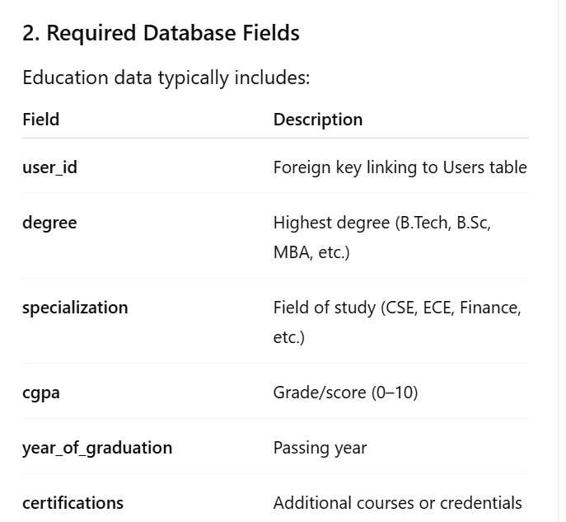

Slide 31
Example SQL table structure:
CREATE TABLE education (
id INT PRIMARY KEY AUTO_INCREMENT,
user_id INT NOT NULL,
degree VARCHAR(100),
specialization VARCHAR(100),
cgpa DECIMAL(3,1),
year_of_graduation INT,
certifications TEXT,
FOREIGN KEY (user_id) REFERENCES users(id)
);

Slide 32
3. Importance of Relational Data (User ↔ Education Table)
Using relational database design:
One User → Many Education Records (if needed)
Clean separation of concerns
Easy joins for API responses
Better for analytics and ML preprocessing
Flexible structure if a user adds multiple educational qualifications later
This is the standard database pattern for user-linked attributes.

Slide 33
Hands-On (During Session)
Students will perform:
1. Implement the Database Model
Depending on the stack (SQL/Prisma/Sequelize/Mongoose), create an Education schema with fields listed above.
Example (Prisma Schema):
model Education {
id Int @id @default(autoincrement())
degree String
specialization String
cgpa Float
year_of_graduation Int
certifications String?
user User @relation(fields: [user_id], references: [id])
user_id Int
}

Slide 34
2. Save Incoming Data From the /education/add API
Receive validated data from the frontend
Insert a new row into the Education table
Link it with the authenticated user's ID
Example flow:
Frontend → API → Validate → DB Insert → Success Response
Outcome: Education details are securely stored and tied to the correct user.

Slide 35
Task (To Be Completed by Students)
✅ Day 5 Task: Create & Integrate the Education Model
Students must:
Create database schema/table for storing education details.
Add fields: user_id, degree, specialization, CGPA, year_of_graduation, certifications.
Connect the schema/model to the existing User model.
Modify the /education/add API to:
Insert received data into the Education table
Return a success response
Expected Output
Data is saved securely in the database
Linked correctly to the user through user_id
No errors in DB operations
Verified through database inspection tools (MySQL/PostgreSQL/Prisma Studio)

Slide 36
📅 Week 2 — Preprocessing + Pipeline + Testing
Day 6 — Introduction to Preprocessing Pipeline
Theory
What preprocessing is required before ML model prediction:
Categorical Encoding (degree, specialization → numbers)
Normalization (CGPA values)
Handling missing data
Data consistency checks
One-Hot Encoding vs Label Encoding.
Hands-on
Build preprocessing functions.
Outcome: Students can convert raw input to ML-ready format

Slide 37
1. What Preprocessing Is Required Before ML Prediction?
Before sending education data to the ML model, raw user input must be transformed into machine-readable numerical format.
a) Categorical Encoding
Convert categories → numbers Examples:
Degree: B.Tech → 0, M.Tech → 1, MBA → 2
Specialization: CSE → 0, ECE → 1, Mechanical → 2
Methods:
Label Encoding
One-Hot Encoding

Slide 38
b) Normalization (CGPA)
CGPA values must be scaled to a range (0–1). Example formula:
normalized_cgpa = cgpa / 10

Slide 39
c) Handling Missing Data
If user leaves fields empty:
Replace with default values
Or mark as “Unknown”
Or skip incomplete entries
d) Data Consistency Checks
Examples:
CGPA must be within 0–10
Year of graduation must be numeric
Degree and specialization must match valid lists

Slide 40
Hands-On (During Session)
Students will:
Build preprocessing functions for:
Encoding
Normalization
Missing value handling
Validations
Test preprocessing on sample inputs.
Example function:
def preprocess(data):
encoded_degree = degree_map[data["degree"]]
encoded_spec = spec_map[data["specialization"]]
cgpa_norm = data["cgpa"] / 10
return [encoded_degree, encoded_spec, cgpa_norm]

Slide 41
Task (To Be Completed by Students)
✅ Day 6 Task: Build Preprocessing Scripts
Each student must:
Create a preprocessing module (Python/Node).
Implement:
Label/ One-Hot encoding
CGPA normalization
Missing value handling
Convert the stored DB data → ML-ready format.
Print final processed vector as output.
Example output:
Processed Input: [1, 4, 0.82]

Slide 42
Outcome
✔ Students understand preprocessing workflow ✔ Raw input → clean ML-ready numerical features ✔ Ready for integration with ML prediction (Milestone 3)

Slide 43
Day 7 — Implementing Encoding (Degree/Specialization)
Theory
Why ML models cannot accept text.
Label Encoding example:
B.Tech → 1
M.Tech → 2
One-Hot Encoding example:
Categories → separate columns.
Hands-on
Encode degree, specialization, certifications.
Store encoded representation.
Outcome: Encoded values ready for model.

Slide 44
Theory
1. Why ML Models Cannot Accept Text
ML algorithms work only with numbers. Text fields must be encoded to numeric format.

Slide 45
2. Label Encoding (Simple Numeric Mapping)
Example mapping:
B.Tech → 1
M.Tech → 2
MBA → 3
Diploma → 4
Used when there is no priority between labels and model is robust.

Slide 46
3. One-Hot Encoding
Instead of one number, create multiple columns:
Degree_BTech → 1/0
Degree_MTech → 1/0
Degree_MBA → 1/0
Used when:
Categories are few
No inherent ordering
ML requires independent features

Slide 47
4. Encoding Certifications
Certifications may be:
Single (string)
Multiple (array)
Approach:
Map common certifications using label/one-hot
Store encoded array in DB
Handle “Unknown Certification” gracefully

Slide 48
Hands-On
Students will:
Encode degree, specialization, certifications using label or one-hot encoding.
Save encoded representation to DB or return it to frontend.
Test encoded output with sample data.

Slide 49
Outcome
✔ Encoded numeric values ready for ML model ✔ Students understand encoding differences ✔ Preprocessing pipeline updated

Slide 50
Day 8 — Normalization & Missing Value Handling
Theory
Why normalization matters (scale difference).
Techniques:
Min-Max Scaling
Standard Scaling
Strategies for missing values:
Fill mean/median
Category "Unknown"
Hands-on
Normalize CGPA.
Implement missing value rules.
Outcome: Clean, normalized numeric data.

Slide 51
1. Why Normalization Matters
ML models are sensitive to differences in data scale. Example:
CGPA = 8.5
Year = 2024
Model may give unfair weight to larger numbers
Normalization solves this.

Slide 52
2. Techniques
a) Min-Max Scaling
scaled = (value - min) / (max - min)
Output between 0 and 1
b) Standard Scaling
z = (value - mean) / std
Useful for models requiring Gaussian distribution.

Slide 53
3. Strategies for Missing Values
Fill with mean/median (for numeric: CGPA)
Fill with category “Unknown” (for degree, specialization)
Drop row (not preferred for user inputs)

Slide 54
Hands-On
Students:
Normalize CGPA values
Implement missing value logic
Ensure every input results in a complete numeric vector
Outcome
✔ Clean, normalized input data ✔ No missing fields ✔ Data ready for model prediction

Slide 55
Day 9 — Integrating Preprocessed Data Into User Profile
Theory
Two-view model:
Raw data (for user display)
Processed data (for ML model)
Importance of storing both.
Hands-on
Save both raw & processed versions in DB.
Verify model-input JSON format.
Outcome: Model-ready data stored consistently.

Slide 56
Two-View Model
Students learn the importance of keeping both raw and processed versions:
Raw Data
For user display (profile page)
Human-readable
Editable
Processed Data
Encoded + normalized
Used only by ML model
Why Store Both?
User sees original text values
Model uses clean numeric vectors
Reprocessing not required every time

Slide 57
Hands-On
Save raw data in education table
Save processed version in education_processed field or separate table
Validate final JSON format fed to ML model
Outcome
✔ Model-ready preprocessed data stored ✔ User profile displays clean raw values ✔ Backend fully prepared for prediction module

Slide 58
Day 10 — Testing, Debugging & Final Verification
Theory
Common issues in preprocessing:
Wrong encodings
Null values
Mismatched formats
How to test pipelines.
Hands-on
Test 3–4 different student profiles.
Check for errors, fix broken flows.
Review preparation for Milestone 3 (Job Prediction).
Outcome: Milestone 2 ready for evaluation.

Slide 59
Common Preprocessing Issues
Wrong encoding mapping
Null values sneaking in
Broken JSON structure
Incorrect normalization formula
Mismatched data types

Slide 60
How to Test Pipelines
Provide 3–4 test profiles
Verify encoding
Check processed output
Run through end-to-end pipeline

Slide 61
Hands-on
Test various student profiles
Debug errors in encoding/normalization
Final check before Milestone 3 (Prediction Module)
Outcome
✔ Milestone 2 fully complete ✔ Stable preprocessing pipeline ready for Job Prediction Model

Slide 62
📌 Milestone 2 Deliverables
✔ Education Input Form working ✔ Frontend validation complete ✔ API to submit education details ✔ Database model created ✔ Preprocessing: encoding + normalization ✔ Clean, processed data stored in profile ✔ Testing completed

Slide 63
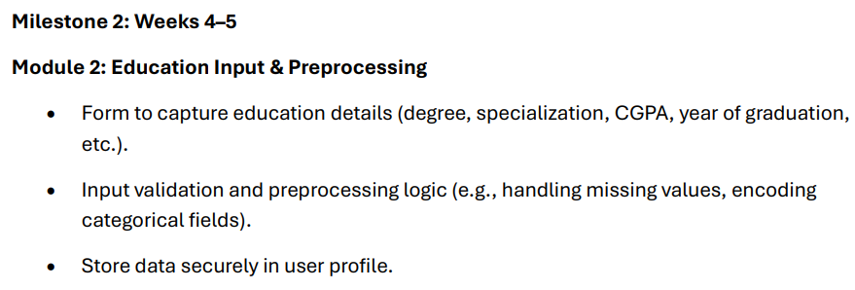

Slide 64
